Slide 1
Data sovereignty
Patrick Sefton | Principal, Brightline Lawyers

Slide 2
Data sovereignty
regulatory access (right to information, privacy)
litigation disclosure
subpoenas & identity disclosure
civil search orders
agency and police search warrants
international issues

Slide 3
Regulatory access
RTI: general right to access government documents
defined process and possible cost to access
exceptions: particular agencies, privilege, where disclosure would breach confidence
Privacy: general right for individuals to access & correct information about themselves
can impose “non-excessive” charge for access
exceptions: risk to safety, privilege, negotiations, misconduct

Slide 4
Litigation disclosure
general duty to disclose relevant documents in litigation
can be a significant exercise
“document” includes “any disc, tape, or other article or any material from which sounds, images, writings or messages are capable of being … reproduced”
exceptions: privilege (not exceptions: confidentiality, sensitivity, privacy)

Slide 5
Subpoenas
subpoena (= “under penalty”)
for production of documents
to attend and give evidence
court issues at request of a party to proceedings
exceptions (subpoenas for production)
if oppressive (overbroad/non-specific, “fishing,” costs not paid)
privilege

Slide 6
Identity discovery
someone has information to identify unknown defendant
eg, vehicle owner from registration: Dept of Transport
eg, customer from IP address: ISP
by subpoena (Qld) or application under special court rule
must have (civil) legal claim
must show subpoena recipient has relevant information
must be highly specific (eg, dates and times)
large organisations (eg, ISPs) have special groups to manage

Slide 7
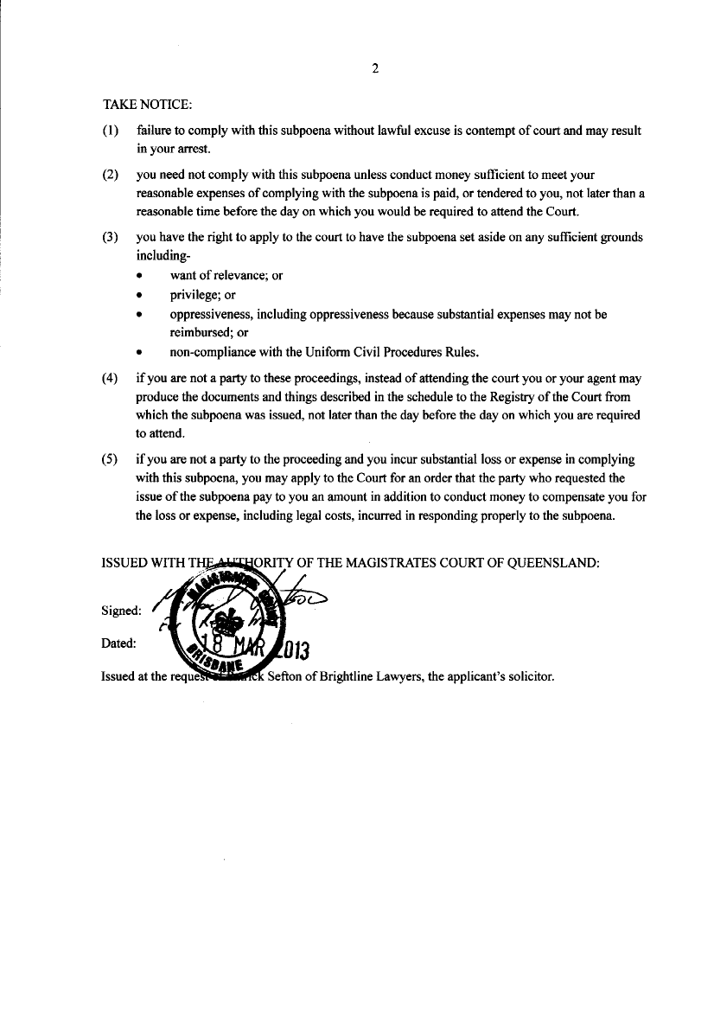
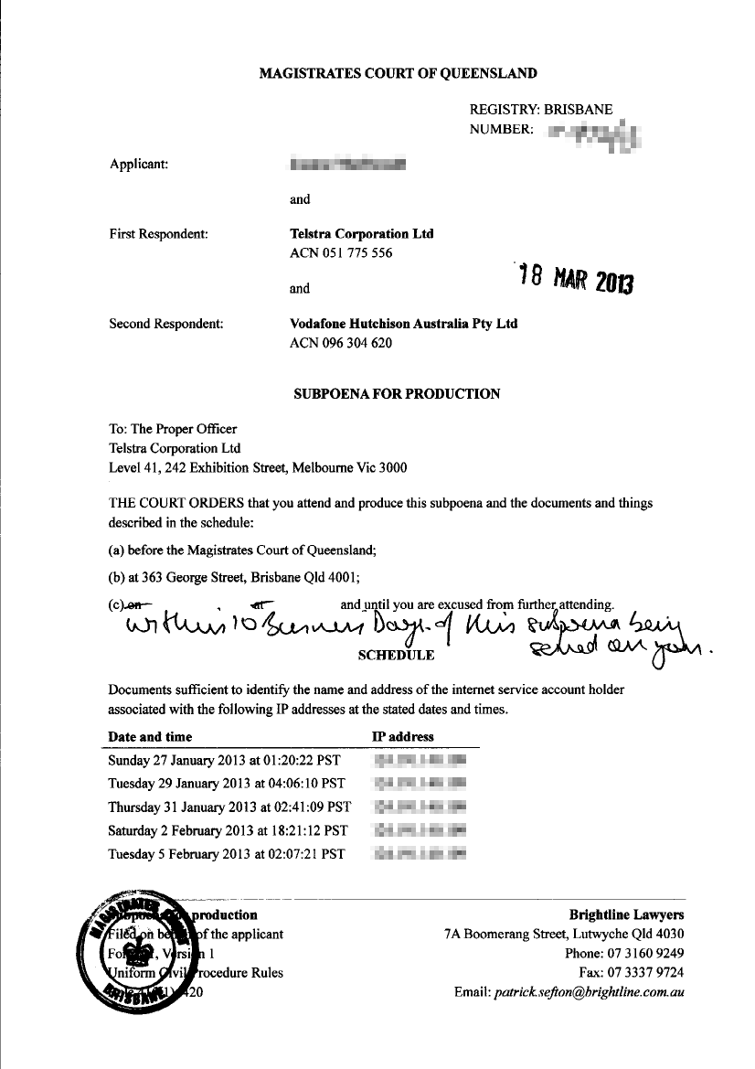

Slide 8
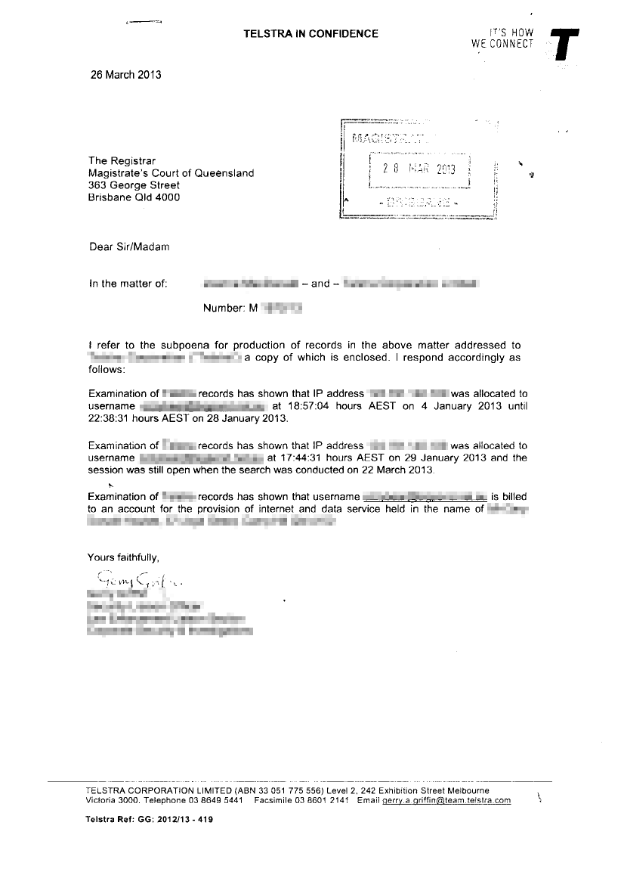

Slide 9
If you receive a subpoena / discovery notice
numbered, stamped by court?
addressed to an individual?
specific?
reasonable costs covered?
reasonable time allowed? (particularly if interstate)
manage for time

Slide 10
Civil search orders (“anton piller” orders)
court order allowing search of private premises
usually IP matters with risk of destruction of evidence
executed daytime only, business days only
usually permits taking forensic copies of data
usually requires subject to provide assistance
eg, electrical power, system access, passwords

Slide 11
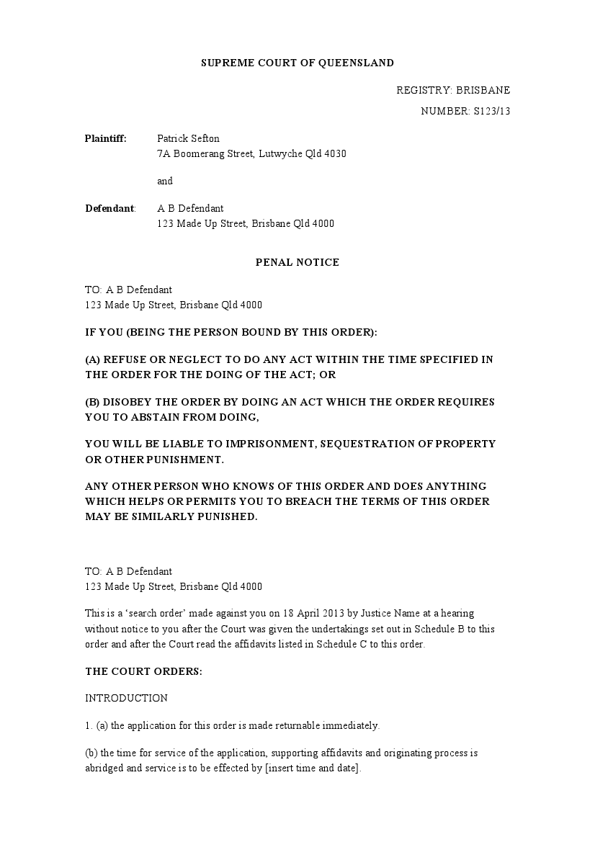

Slide 12
If you are subject to a civil search order
can hold to read material, obtain legal advice (2 hrs)
can apply to set aside
eg, if court has not been given a complete picture
can preserve privilege
individuals entitled to separate self-incriminating material
can observe search (but not interfere)

Slide 13
Agency and police warrants
police warrants
notice to produce, search
access to storage device, assistance (eg, passwords)
other enforcement agencies have search powers
ACCC, ACC, ASIC, APRA, ATO, Customs & Immigration, intelligence & security agencies
can obtain forensic copies of systems, or seize (as last resort)
can require assistance (as police)

Slide 14
What if you’re the subject of a warrant
can’t usually hold to seek advice
can preserve privilege
watch what you say
admissions, good-cop/bad-cop
all activity and discussions probably recorded
can observe search
can be arrested immediately, if problem material found

Slide 15
International issues
most police forces can obtain material under warrant (sometimes without warrant)
jurisdiction extends to in-jurisdiction entities operating internationally
eg, Google, Amazon, Microsoft operating in Australia/elsewhere are subject to US police and agency warrant powers
Australia recently signed “Cybercrime” treaty: mutual legal assistance

Slide 16
Practical responses to enforcement requests
in writing?
signed by authorised official?
issued under an appropriate law?
overbroad? – negotiate with issuing agency
notify affected persons (unless prohibited)

Slide 17
Thank you
Patrick Sefton Principal, Brightline Lawyers Phone 07 3160 9249 Mobile 0407 756 568 patrick.sefton@brightline.com.au

