Slide 1
Digital innovations and in-house legal practice
Patrick Sefton | Principal, Brightline Lawyers

Slide 2
Digital innovations
cloud computing
back-end and basic components
dropbox and friends
office apps
practice management systems
mobile computing
mobiles and tablets – state of play
mobile apps for lawyers
document automation
decision-support and expert systems

Slide 3
And the survey says…
“most exciting technology or trend”
tablets / BYOD support
virtualisation
cloud computing
sharepoint
mobility apps
web apps
median spend: $13,000 /lawyer/year
Notes:
2011 survey of law firm technology decision-makers, from International Legal Technology Association’s “Technology Purchasing Survey” 2011
Tell story of clinical system implementation “can I read the notes on my iPad?”
Note only 11% plan to provide tablets, 55% say employees can BYOD and firm will support
What’s missing: ANY kind of basic, licensed software package … no one is saying the next version of Office is going to be exciting

Slide 4
Cloud computing
many different names (but only slightly different meanings)
broad definition:
ICT capability
provisioned remotely, delivered as a service
with abstraction of detail
Notes:
data hosting, application hosting, ICT managed services, ASP services, software-as-a-service, platform-as-a-service, infrastructure-as-a-service, utility computing
Deal with ICT Managed Services in a bit more detail. Closer relationship. An outsource. You will get a contact/relationship manager who will manage the provision of services on external infrastructure for your business. Typically used for the outsource of an existing IT function.
Distinguish from “cloud” in the sense that cloud is usually a little more “self-serve”

Slide 5
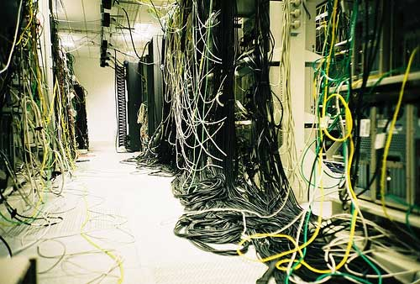
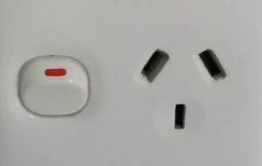
← less of this
more like this → …

Slide 6
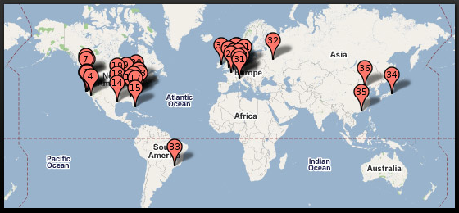
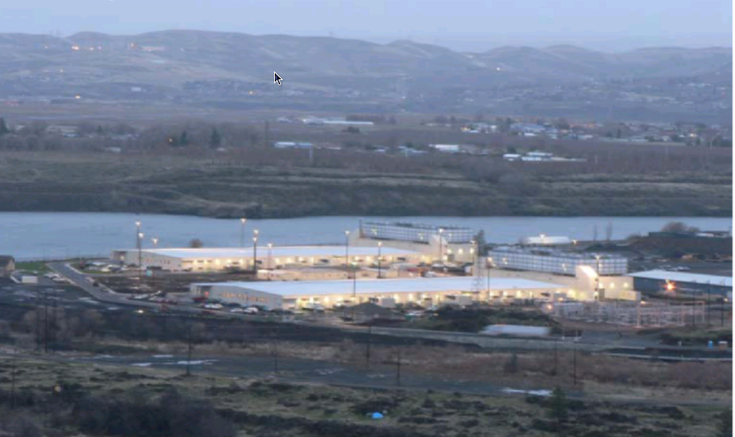
...connected to these →
Notes:
Google’s (The Dalles) Oregon data centre on the Columbia river
Big warehouse full of commodity servers
NB Google building USD120M DC in Singapore (+Taiwan and HK), operational by 2013. NO DC in Australia. Policy not to disclose where data is physically located.
Amazon will tell you which CITY your DC is located in (but not a street address)
Apple building multiple DCs in US (Oregon; North Carolina) including a massive 500,000sqft/78MW/USD1B facility in Maiden NC
Cost drivers for DCs: tax breaks, land costs, power costs, communications
Facebook’s standard facility layout uses 25MW
Total about 2% of global power generation used by DCs.

Slide 7
Back to the survey: cloud
“what cloud services will be used?”
disaster recovery / business continuity
storage / backup / archive
email
document management
“cloud concerns and challenges?”
security / confidentiality
accessibility of data
Notes:
Relatively simple approach reflected in current plans surveyed
Security and confidentilaity were first by a mile
Accessibility was a distant second

Slide 8
Opportunities
sure, cost reduction
local IT headcount
server, storage, infrastructure cost
licence costs
but main benefits reported as
resilience (backup and DR)
scalability and flexibility
Notes:
Dropbox for storage slightly different model, charging for storage ($20/100GB/month), or for teams ($13/user/month for 5 users)

Slide 9
Opportunities – ubiquity
nature of cloud services is to be available anywhere there is internet connectivity
mobile devices
out-of-office locations
reduce “synchronisation” issues
improve security
fewer copies particularly on notebooks, data sticks
Notes:
By synchronisation issues I mean making a copy on your notebook, and on a data stick, and emailing it to yourself
About 2.3% of notebooks are lost or stolen each year (about 30M); 7% of notebooks lost/stolen in their useful life
An interesting stat: more than 1M notebooks are lost just at airports each year, ~60% are returned to lost-and-found, where almost none are claimed

Slide 10
Opportunities – service levels
replication, redundancy, scale, dedicated organisation = higher quality service (?)
eg, both Microsoft and Google offer 99.9% availability, even on low-end cloud products
ie, down no more than 43 minutes/month
much better than the average for in-house systems
Notes:
“Three nines” availability is about 40min/mth
Gold standard is “five nines” or 99.999% uptime = just over 5 minutes/year down
Windows Azure (component-based) offers 99.95%
Amazon AWS claims “eleven nines” as its in-practice data resiliency performance(!)
Might recall the Polaris DC in Springfield about this time last year went down for 24min on a quarter of its floor (due to some kind of testing error)
It’s not that personnel are better or worse, it’s just that the high-availability infrastructure is cost-prohibitive unless you operate at a massive scale. For example, I worked on the <client> agreement for <govt-personal> records: clearly high-availability is required. The cost of achieving the high-availability required (compared with the cost of the system which would just “do the job” but have no failover redundancy) almost doubled the infrastructure cost.
“Undifferentiated heavy lifting”

Slide 11
What’s available – infrastructure
Product Name | Type | Cost
Amazon Web Services (AWS) | Full range of cloud infrastructure building blocks (compute, storage, DB) | Compute/DB: 9c-92c/hour Storage: 5.5c to 12.5c/GB/month Network: 19c/GB out
Google App Engine | Application-focused low-level infrastructure | Scaled automatically according to demand and limited by budget; min 8c/hour compute, 13c/GB/month storage, and other metrics
Microsoft Azure | Full range of compute, DB, storage and network infrastructure | Compute: 3c-97c/hour DB: from $5/mth Storage: from 12.6c/GB/month Network: from 19c/GB out
Notes:
Compare to even the cost of power in running own servers (400W@20.5c/kWh=$8.20/hr), ignores capital cost, floorspace, personnel, platform software licences, etc

Slide 12
What’s available – Dropbox & co
Product Name | Type | Cost
Dropbox | User-friendly storage available on multiple platforms | 2GB free $20/month for 100GB or $13/user/month
Apple iCloud | User-friendly storage available on multiple platforms (not Android), with integrated backup in iOS 5 | 5GB free $20/year for 15GB $100/year for 55GB
Amazon Cloud Drive | User-friendly storage available on multiple platforms | 5GB free $20/year for 20GB $100/year for 100GB
Microsoft SkyDrive | User-friendly storage available on multiple platforms; Office integration | 25GB free
Google Drive | Coming soon! | Unknown

Slide 13
What’s available – office apps
Product Name | Type | Cost (/user/month)
Google Apps | Documents (including spreadsheet, presentation graphics), email, calendar, contacts, collaboration tools, document storage | $5
Microsoft Office 365 | Email, calendar, contacts, MS Office web apps, document storage, collaboration tools, document storage | $8
Salesforce | Customer relationship management (account and contract data, approvals and workflow, email, calendaring, contacts, quotes, analytics) | $21-$180

Slide 14
What’s available – legal practice management
Product Name | Type | Cost (/user/month)
Rocket Matter | Legal practice management | $50
Clio | Legal practice management | $25-$50
LawRD | Legal practice management | $19
Gomatters | Legal practice management | $8-$16
Typically including: calendaring, contact management, task tracking and time capture, and accounts and invoicing
Clearly trust accounting would need to be localised and approved before that function was made available locally

Slide 15
Issue – data sovereignty
the Big Issue with cloud services
your data does not reside on your own infrastructure
right and continuity of access
security / confidentiality
compliance
jurisdiction
Notes:
Good metaphor is an outsourced file storage and management company (eg sending all your files to Recall, because you don’t want to pay for file storage space in your office) BUT they store your files in different locations in the warehouse a page at a time and only they know how to re-assemble them. Oh, and they outsourced the actual warehouse, and it’s in the Ukraine.
Right and continuity of access: contract should allow access / take copy / periodically obtain copy of data
should be provided in an appropriate exchange format
may be different from provider’s own internal format, which may be proprietary
should address insolvency, control change
Of course, Legal Profession (Solicitors) Rule 2007 Rule 3 – Confidentiality: prohibits disclosure of confidential client information without client authorisation

Slide 16
Information privacy compliance
NPP4 Data Security: must take reasonable steps to protect personal information
should be reflected in service provider agreement
NPP9 Transborder Data Flows: o’seas recipient must be bound by similar privacy law
should take care to determine which jurisdiction the data is located/stored in, if not Australia
IPA s33: special rules for Qld Govt agencies proposing to transfer data o’seas
Notes:
special provisions about cross-border transfers
by agencies (s33 Information Privacy Act 2009 (Qld))
consent/authorisation by law/serious threat to life/health/safety/welfare, or at least 2 of the following:
 equivalent treatment
 necessity
 individual benefits, consent impracticable & likely
 reasonable steps to protect

Slide 17
Information privacy compliance
Concerns about government access
“library records” provision of USA PATRIOT Act allows access to records of entities located in the US, or which are US-based
Bank of Valletta v NCA [1999] FCA required an Australian branch of a foreign bank to produce o’seas documents in Australian criminal proceedings
Australia is party to a number of mutual legal assistance treaties allowing access to data for the purpose of criminal investigations
Notes:
There was some minor hysteria last year when Microsoft launched its Office 365 cloud product, and some enterprising journalist asked Microsoft in the UK whether, because they were a US company, customers’ data would be subject to access under the Patriot Act (“Uniting (and) Strengthening America (by) Providing Appropriate Tools Required (to) Intercept (and) Obstruct Terrorism Act of 2001”), and Microsoft said yes it would.
It turns out that’s right, but it was probably always the case, even in the absence of the Patriot Act, and that other countries including Australia have that right as well when investigating criminal behaviour.
Incidentally (and ironically), does anyone know how the Sept 11 conspirators communicated with one another? Hotmail (save as draft)

Slide 18
Mobile computing
smartphone/tablet shipments have exceeded notebook/desktop since Q4-2010
1B smartphones/tablets now in use
mobile internet users to exceed desktop users by Q1-2014
“consumers increasingly expect service 24x7 from palms of their hands”
Notes:
About 150M smartphones shipped in Q4-2011 (Samsung 23%, Apple 24%); year-on-year growth 58%
Quote is from Morgan Stanley report on internet trends

Slide 19
Mobile apps for lawyers
App type | Examples
Task managers, note takers | Note2self, Evernote
Time recorders | (Many)
Voice recognition, text-to-speech | Becoming built-in
“Virtual Assistant” | Siri, Vlingo, becoming built-in
Legislation and caselaw reference | AustLII, LexisNexis Mobile Case Search
Cloud storage and access | Dropbox, Evernote
Specialist single-purpose legal | Consumer Law Converter
Law firm house apps (brochureware) | (Many)

Slide 20
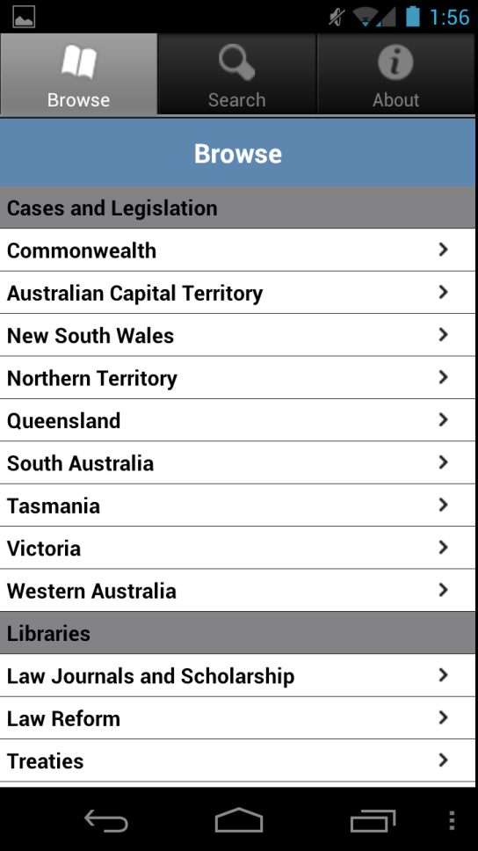
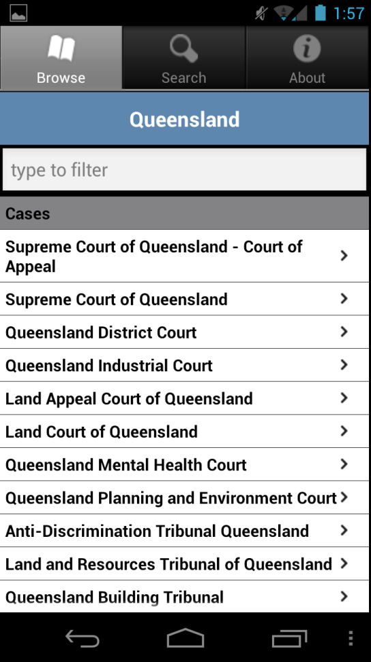
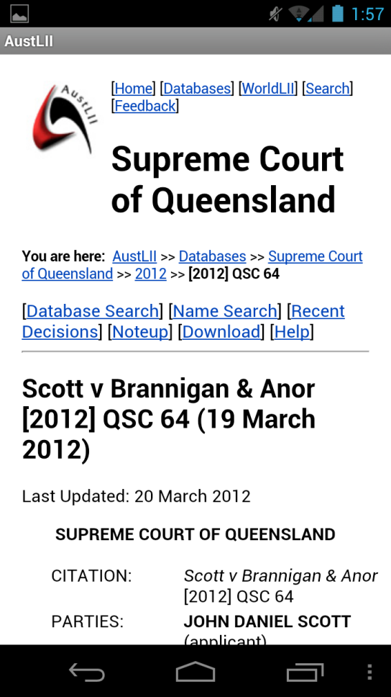
Example: AustLII mobile app

Slide 21
Tablet functionality for lawyers
support mail, calendar, contacts
for review, annotation not creation
support data ubiquity (Dropbox or similar)
support dictation (Siri or similar), annotation (PDF Expert or similar, CloudOn or similar)
ideally support paperless (or paper-lite) workflow
consider ‘read not write’ rule in meetings
Notes:
you will still need an assistant or a PC or at least a keyboard
Workflow: think about the paper in your life

Slide 22
Security and encryption
important
more so if data outside control
subtle and complex
seek expert advice
Notes:
Wireless access point spoofing
Firesheep “one click” HTTP session hijacking
NB Offence under s408E of the Queensland Criminal Code “restricted access computer”

Slide 23
Document generation
moving from templates to document generation / automation / assembly
systemises some stages of legal work
eg, Exari, Rapidocs LawDraft, Intelledox, Kiiac, Softdocs/HotDocs
more sophisticated templates & libraries
on-line questionnaire style with guidance, followed by document assembly
learning from financial services
ideally database-driven from “source of truth” DB
some going to cloud-based systems
Notes:
Intellidox announced it was offering a cloud-based document automation system earlier this month

Slide 24
Legal expert systems
Notes:
Richard Susskind develops the idea that legal services range from completely bespoke, through standardised, systematised, packaged, to commoditised (and then automated??). But good lawyers can innovate all along the way as well as just at the “top end,” but more by managing process and exploiting technology.

Slide 25
Legal expert systems
Haley/RuleBurst -> Oracle Policy Automation
“Enterprise policy automation”
policy modelling and automation software for legislative and regulated industries
Neota Logic
“Microsoft Excel for compliance”
Notes:
combines individually powerful reasoning methods—decision trees, decision tables, if/then rules, calculations, weighted factors, spreadsheets, case-based reasoning and others—into a single expert engine that can manage problems of great complexity and subtlety for thousands of users and millions of transactions
Neota Logic applications can be built to provide answers and guidance on topics such as these:
General Counsel
Cross-border insolvency risks
European and other data privacy regulations
Insider trading
Intellectual property processes: freedom to operate, patent prosecution
R&D and investment tax credits
Restricted stock sales
Sales and use taxes
Transfer pricing

Slide 26
Issues
work well when there are objective (“bright line”) tests, narrow (even if complex) problem domains
can’t make value judgements; can provide factors, criteria, examples; can work in conjunction with expert (“decision-support”)
can be costly, time-consuming, error-prone to extract and formalise expertise / regulation

Slide 27
Thank you
Patrick Sefton Principal, Brightline Lawyers Phone 07 3160 9249 Mobile 0407 756 568 patrick.sefton@brightline.com.au

