Slide 1
Data: it’s not just about breaches
Patrick Sefton | Principal, Brightline Lawyers

Slide 2
Intro and perspective
data is a problem child for lawyers (and accountants)
meanwhile:
exponential data creation, storage
rapidly falling costs, improving accessibility, new tools
new uses for large data repositories in particular Machine Learning type AI
worth considering some broader legal issues around data

Slide 3
Is data “property”?
No.
Victoria Park Racing v Taylor
Breen v Williams
Your Response v Datateam Business Media
Dixon v R

Slide 4
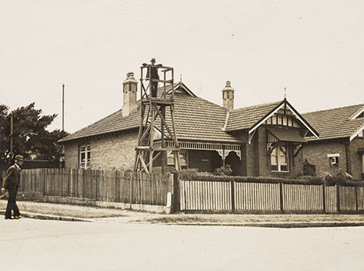

Slide 5
Does copyright protect data?
No. (well, not unless the data originated by an author from some independent intellectual effort)
IceTV v Nine
Telstra v Phone Directories Company

Slide 6
Can data be “confidential”?
YES!
but a personal obligation, not proprietary
and only where criteria are met:
in fact confidential
disclosed in circumstances of confidence
or, contract with confidentiality terms

Slide 7
Proving confidentiality
“In fact confidential”
Identify confidential data, use different process
Internal access controls, “need to know”
Practical external controls, eg, parts only, query only, throttles on queries or access
Audit trail and audit of access
“Imparted in circumstances of confidence”
Confidentiality notice or click-wrap before access
Warnings in communications disclosing data
Marking on screen or printouts

Slide 8
Leveraging data
Trade-off between keeping essentials…
reduce risk of breach, minimize attractiveness as target
minimise compliance costs
[personal information] comply with APP 3.1, 3.2, 11.2
and keeping everything…
storage/processing now very, very low cost
you never know when something might be useful (Machine Learning AI being a case in point)
increase organizational value
improve decision-making

Slide 9
Risks of being data-driven
“In God We Trust, all others bring data” (W. Edwards Deming)
More learning-oriented than received-wisdom
BUT
Data-reliance / Machine Learning AI may entrench discrimination/bias already present in training data
Examples: imSitu SRL, California PSA System, PredPol

Slide 10
imSitu SRL

Slide 11
De- and Re-identification
August 2016
de-identified MBS/PBS claim data on 10% of population – 2.9M individuals
badly flawed encryption
linkage attacks (with enough data points, everyone is unique)
potentially identified entire medical history of multiple individuals

Slide 12
MBS/PBS 10% outcomes
data withdrawn
the mathematics is important
de-identification guidelines cannot be assumed to guarantee privacy protection
some datasets can never be published in a useful form while retaining individual privacy
proposed re-identification offence

Slide 13
De-identification decision-making framework
OAIC & Data61 (CSIRO)
comprehensive and non-technical approach
model of issues, areas for investigation
basis for scoping/briefing/discussion with experts
focus on “data situation,” ie, data in context
emphasis on understanding, identifying, planning
may still be judgement calls, including whether to release at all (cf MBS/PBS release)

Slide 14
NDB – a “black hat” view
small business exemption: 94% of AU enterprises
state depts & agencies also excluded
only unauthorized disclosures
only where likely to result in serious harm
will guidance in s26WG become exceptions?
remedial action is effective self-certification
notification options & practicability
potential for abuse of OAIC declaration process
application of penalties is light-touch

Slide 15
Data breach & class actions
a real concern for major breaches
Equifax breach may cost USD600M: technology upgrades, legal fees, free credit monitoring services, provision for claims
at least one current class action in NSW (NSW Ambulance) breach of confidence, breach of contract, misleading conduct, tortious invasion of privacy

Slide 16
Data & commercial transactions
significant business asset, worthy of consideration
consider copyright, confidentiality, regulated data
copyright: explore subsistence & providence, existing licence arrangements
confidential: explore steps taken to maintain confidentiality, nature of relationships where disclosed
regulated: nature of regulation, compliance steps

Slide 17
Exploiting data
typically via “licence” (even where no copyright)
confined in usual ways: exclusivity, geography, time, field or purpose of use.
if confidential, confidentiality terms (!)
if regulated, to comply with regulation, to assist with enquiries, complaints and investigations
ownership / delivery-up / destruction
warranty and liability (typically excluding liability from use/reliance on data)

Slide 18
Thank you
Patrick Sefton Principal, Brightline Lawyers Phone 07 3160 9249 Mobile 0407 756 568 patrick.sefton@brightline.com.au

