Slide 1
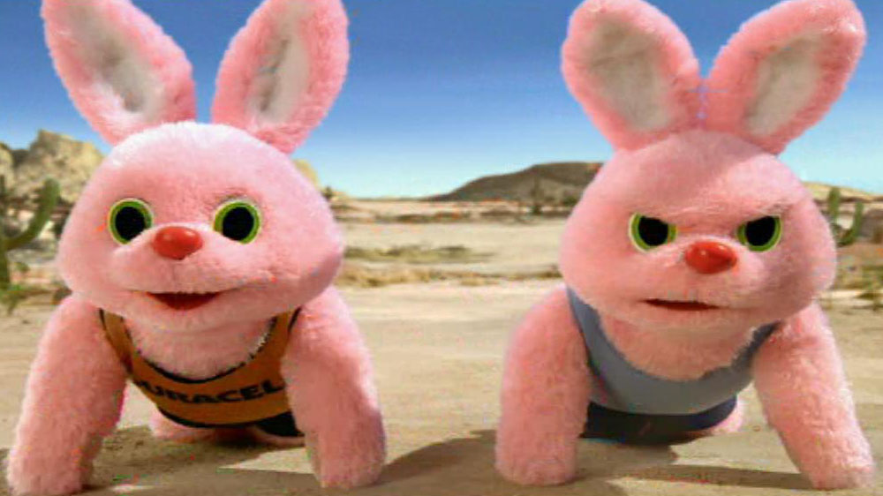

Slide 2
Comparative advertising
Patrick Sefton | Principal, Brightline Lawyers

Slide 3
Comparative advertising
Powerful marketing tool
In one sense, highly pro-competitive
Comparatively rare in Australian environment
Legal risk area (compared with non-comparatives)
Particular risks with respect to price comparatives
Significant source of disputes between competitors

Slide 4
What laws apply
Comparative advertising is allowed
Including with respect to price
Courts do not consider “inherently disreputable”
Australian Consumer Law applies
misleading or deceptive conduct s18(1)
false or misleading representations s29(1)

Slide 5
Price comparisons
Absolutely key concept in marketing
Very powerful in comparative advertising
Because it’s so powerful, courts, competitors expect strict compliance
Essential: overt price comparison claims not misleading
Also: ensure implications not misleading

Slide 6
Case Study: OPSM v Specsavers
Optical industry $1.3B/year (2010)
Rapid growth
OPSM the incumbent – “Myer” of optical stores
Specsavers the newcomer – “Target” type positioning
Specsavers started $1M price comparison campaign on national free-to-air TV

Slide 8
Voiceover “On average OPSM customers paid over $480 for their prescription glasses. We believe that’s too much. That’s why at Specsavers our customers paid on average over $114 less for their prescription glasses than OPSM customers.”
Disclaimer Based on 1313 consumers aged 18 and over who bought prescription glasses (Jul 2009-Jan 2010). Roy Morgan Research 2010. Excludes health fund rebates.

Slide 9
OPSM v Specsavers
Three problems raised by OPSM
exclusion of health fund rebates held: no, consumers would not be concerned
price ($480) vs saving ($114) expressed side-by-side held: no, the point of comparison was clear from text and voiceover
amounts were per-visit cost not per-pair-of-glasses cost held: yes, the expectation supported by the image and not dispelled by the voice or disclaimer: contravenes ACL

Slide 10
Duration of campaigns
Comparative advertising alerts a specific competitor
Competitor may change commercial position quickly (example: change pricing)
Ad may become misleading if commercial basis changes
Comparative advertising therefore suited to short, sharp campaigns

Slide 11
Product comparisons
May not be an apples-to-apples comparison
Products unlikely to be “best” in all metrics, including price. Can you compare across only strong point(s)?
Can you select competitor’s weaker / non-premium product for comparison
Is this acceptable? What are the rules?

Slide 12
Case Study: Energizer
Energizer/Duracell against Gillette/Eveready
Familiar “Energizer bunny” campaign for batteries
Comparative on one technical aspect: capacity (power)

Slide 14
Voiceover
“Which lasts longer? Duracell Alkaline or Eveready Super Heavy Duty batteries?
While Duracell Alkaline keeps on Running, Eveready Super Heavy Duty just can't keep up.
Uh Oh, no matter what they try it won't help.
With up to 3 times more power Duracell always beats Eveready Super Heavy Duty”
Disclaimer (not voiced) Eveready Super Heavy Duty is a cheaper non-alkaline battery. In AA, AAA, C and D sizes only

Slide 15
Energizer case
Gillette/Eveready complaint:
comparison is unfair therefore misleading
products are not “approximate peers”
Eveready has an alkaline battery which would compare
to be fair, comparison should also address price
consumers will be left with the impression that Energizer is simply “better” product without making technology/price trade-offs clear

Slide 16
Energizer case – outcome
Close call (decided on appeal)
Assists that case very specific (function, product)
Not a comparison of value, but particular function
No general notion of “unfairness” in misleading conduct
Comparisons are OK, as long as they’re not misleading
Consumer can decide at point-of-sale, when price known

Slide 17
Comparative advertising online
Naturally, the same law applies
Online more like press than TV: less about first impressions and more about the detail
Ensure geographical scope of online campaign corresponds with correctness of comparison (eg, restrict to relevant city, state)

Slide 18
Summary of tips and tricks
Comparative advertising is allowed in Australia
Must not be misleading
Ensure what is claimed/testable is true (no misleading half-truths)
Provisos may be included in disclaimer / voiceover
Ensure accuracy for life of campaign (short, sharp campaigns)
Consider medium: TV ephemeral, press more details-oriented
Avoid “better value as a whole” claims: stick to specifics
Stay narrow where possible with respect to products, features

Slide 19
Thank you
Patrick Sefton Principal, Brightline Lawyers Phone 07 3160 9249 Mobile 0407 756 568 patrick.sefton@brightline.com.au

